Slide 1
Model Review of CHL Intervention SD Model
Peter Hovmand
June 4, 2025

Slide 2
Reference mode (for Hawai’i)

Slide 3


Slide 4
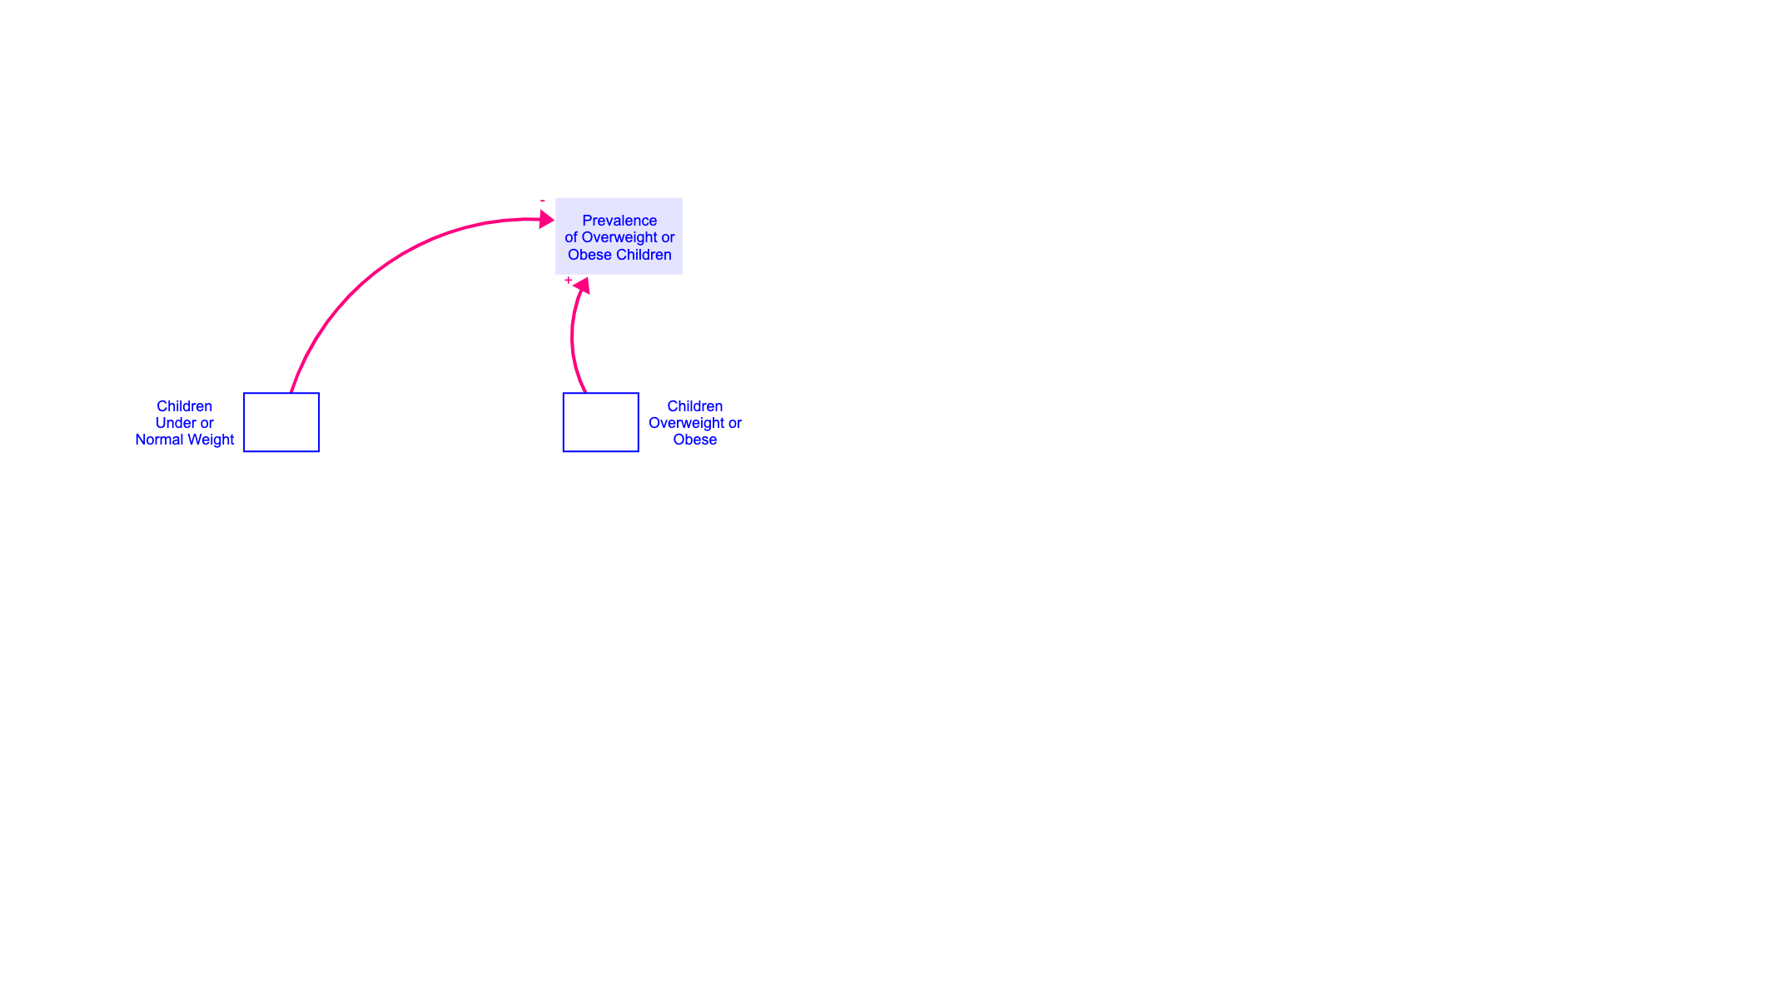

Slide 5
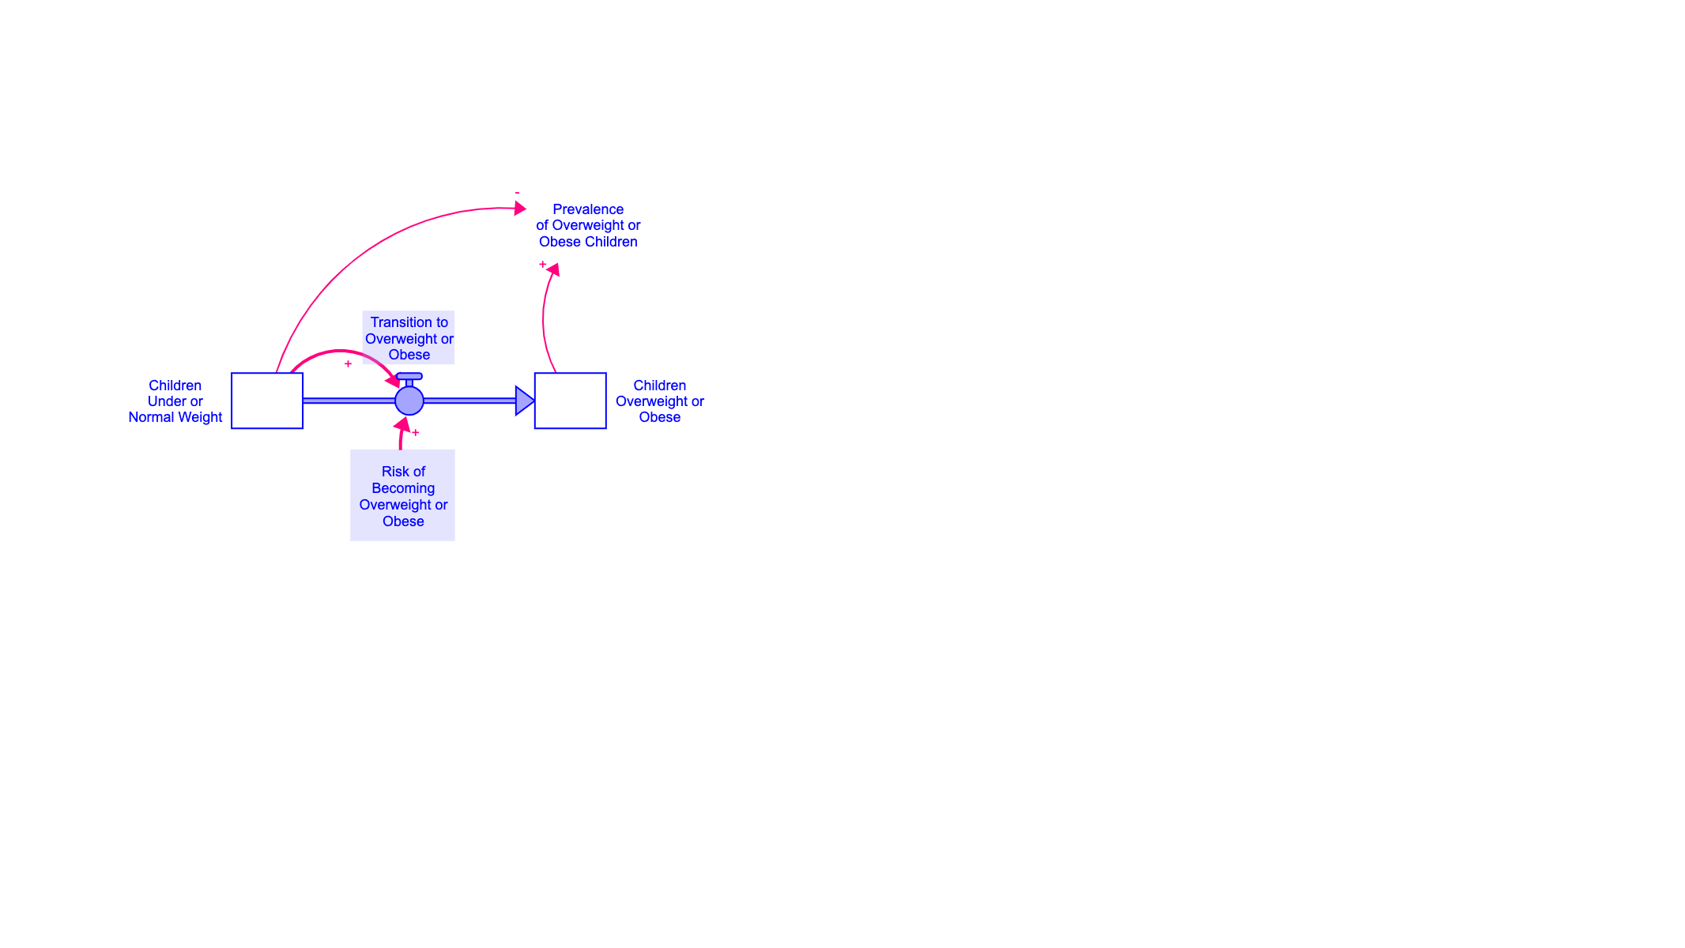

Slide 6
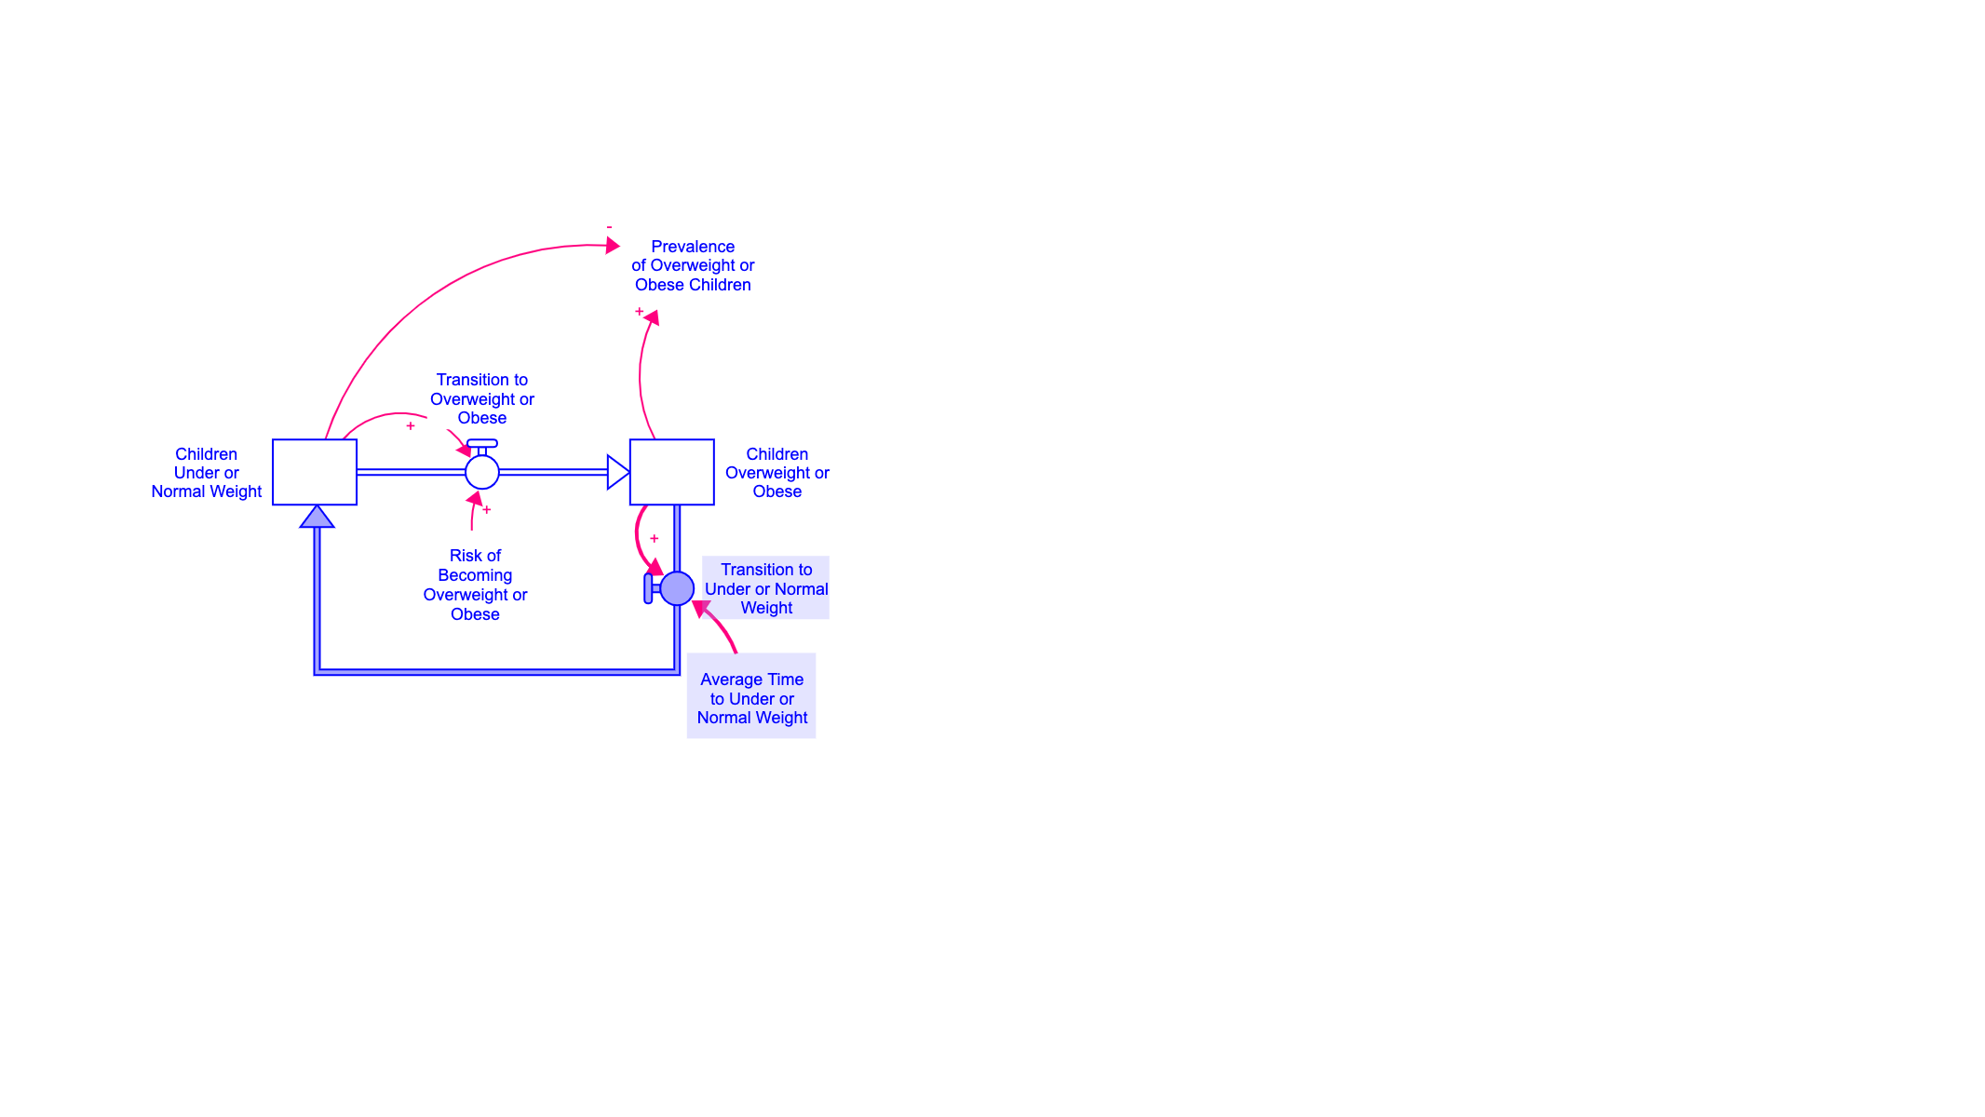

Slide 7
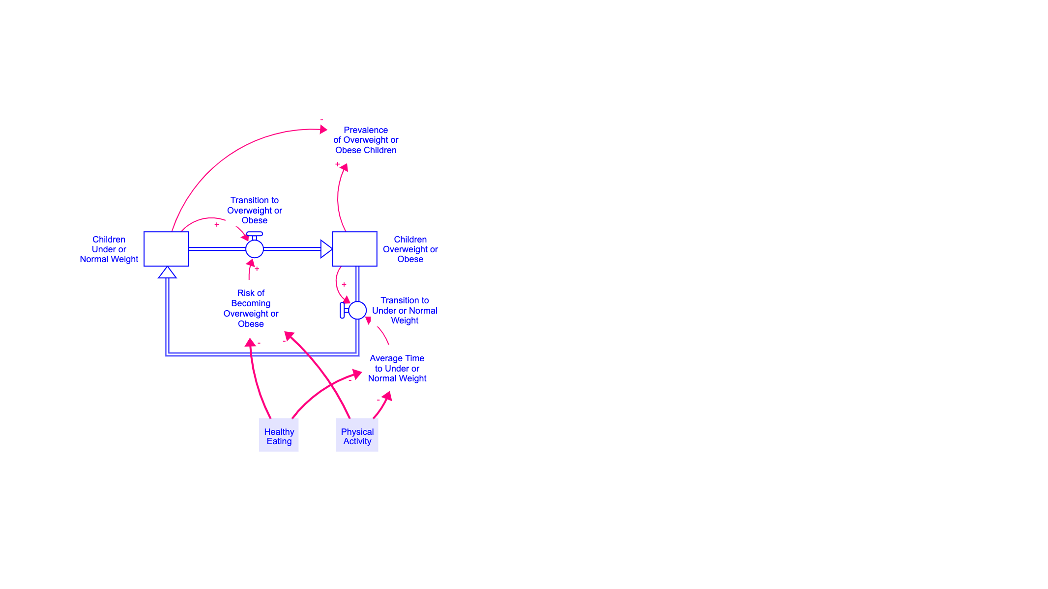

Slide 8
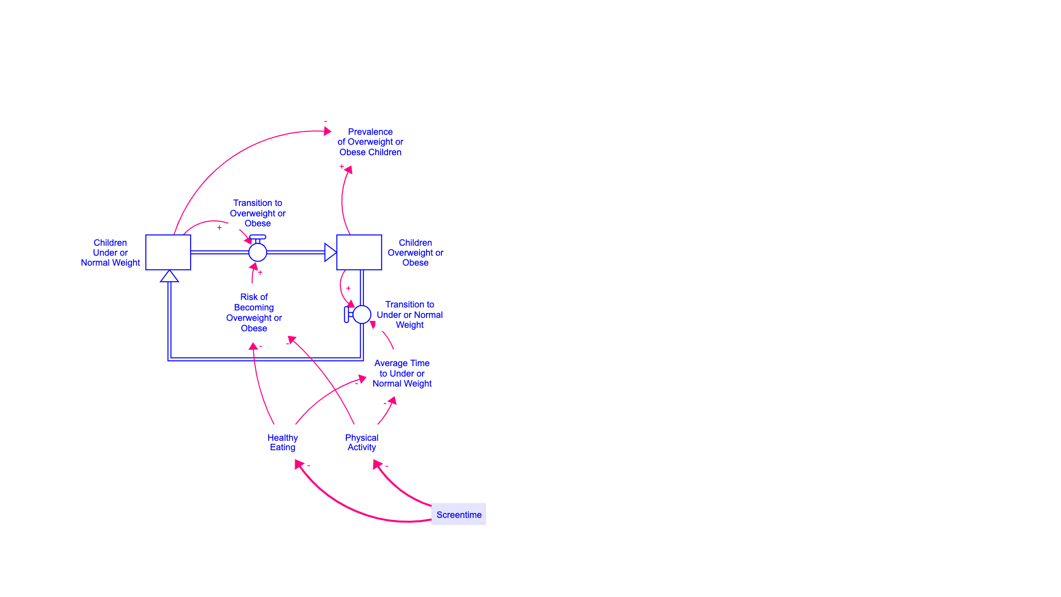

Slide 9
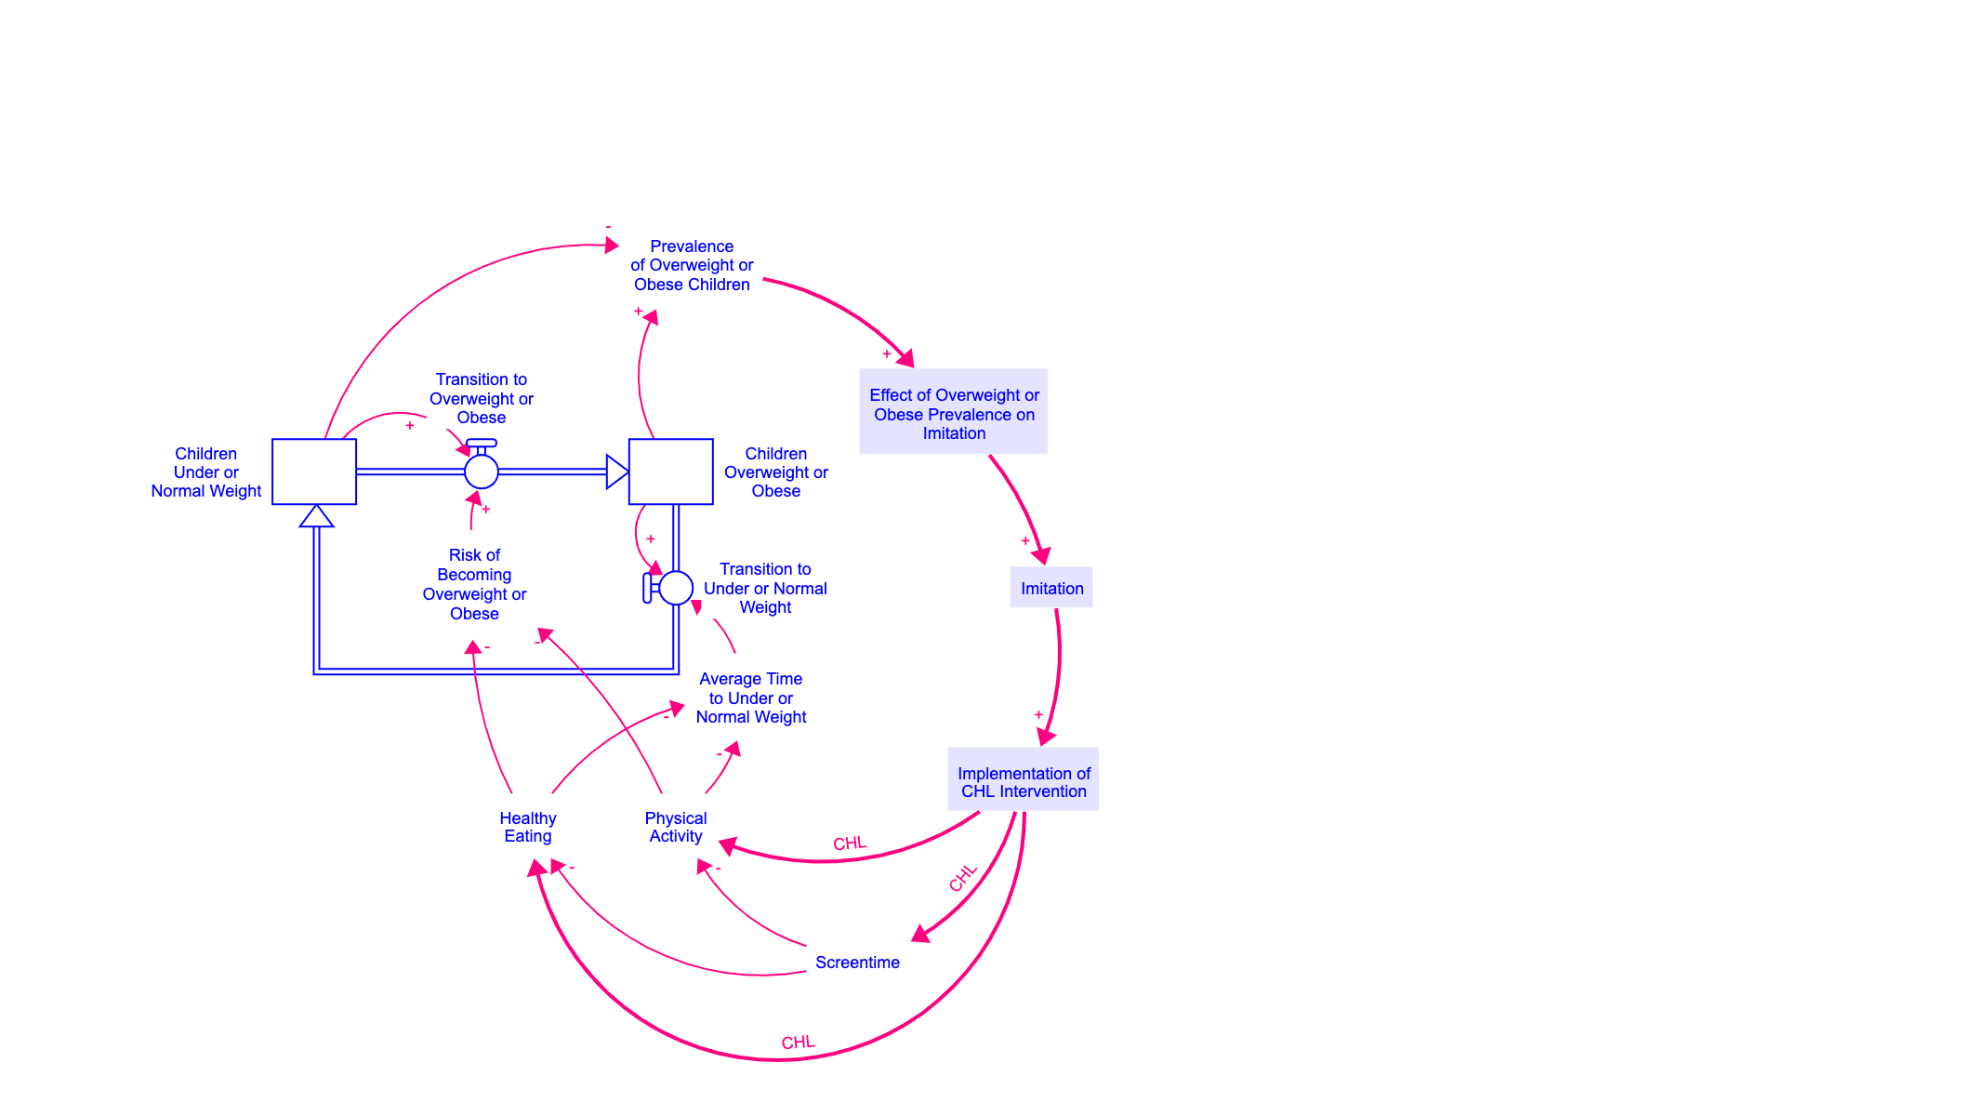

Slide 11
Dynamic hypothesis

Slide 12
Testing dynamic hypothesis

Slide 13
Test fails
Not the same

